Slide 1
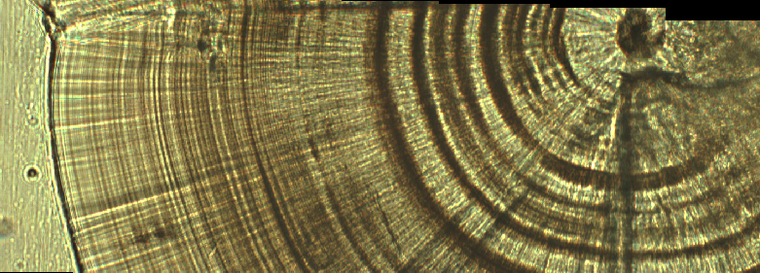

15 days
30 days
45 days

